Slide 1
Final Capstone The Battle of Neighborhoods
Project Name: Opening a bookstore in NYC
Suha K. Assayed

Slide 2
Introduction: Opening a Bookstore in NYC provides a well-stocked inventory of books, magazines, computer hardware and software, office and athletic equipment. It can target all students into different stages of educations and organizations such as Universities, Colleges , Schools, etc. New York City has many nationally important independent universities and colleges as well as many primary and high schools. There are about 594,000 university students in New York City attending around 110 universities and colleges.

Slide 3
Problem statement
I will start by exploring the academic organizations in NY city, and I will
attempt to answer to following questions:
Where should I open my book store ?
In what Neighborhood and/or borough should I open my book store.

Slide 4
Problem statement
I will start by exploring the academic organizations in NY city, and I will
attempt to answer to following questions:
Where should I open my book store ?
In what Neighborhood and/or borough should I open my book store.

Slide 5
Data Selection
To consider the problem I used the below data sources:
First:
https://cocl.us/new_york_dataset
I used this link merely for giving me general information about NYC's boroughs and neighborhoods as well as the distance between cities.
Second:
Foursquare API :I can consider this resource is my primary data resource to gain the most important locational information.

Slide 6
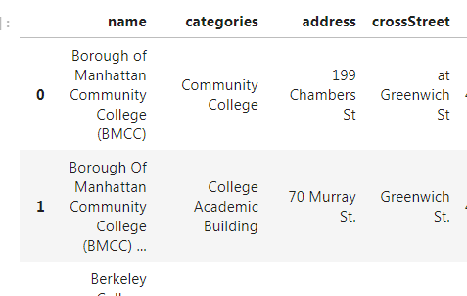
Cleaning The Data
I utilized the Foursquare API to explore the boroughs in NYC. I designed the limit as 30 venue and the radius 1000 meter for each borough from
their given latitude and longitude information.
Then I’ve normalized the results from.json file to the different DataFrames.

Slide 7


Methodology:
By using Foursquare API I’ve explored all academic organizations in NYC

Slide 8
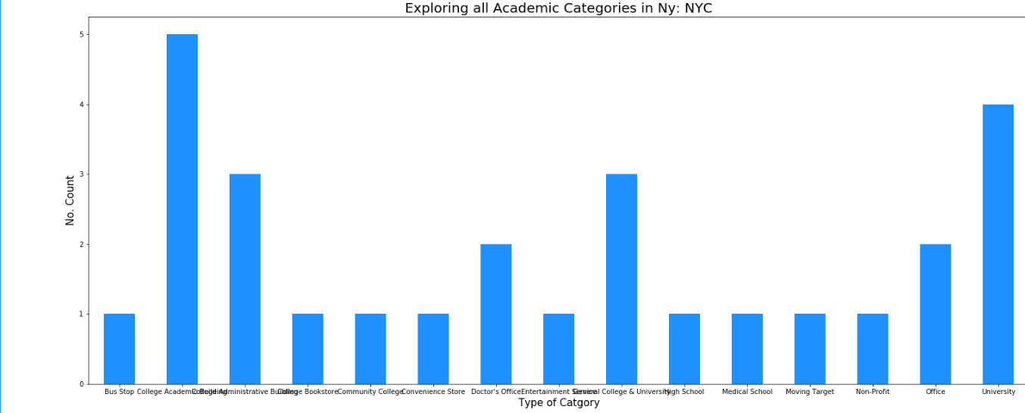
- Exploring The Data:
Exploring all academic organizations in NYC as the below Bar chart:

Slide 9
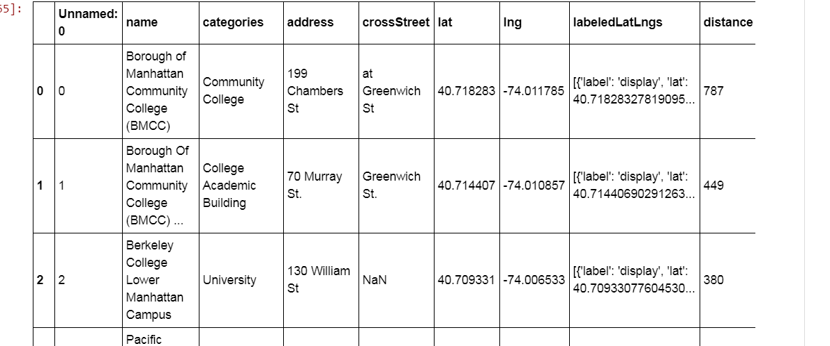
Now we can see the data along with Lat & Lng to different Academic organizations in NYC (Colleges, Universities, School, etc)

Slide 10
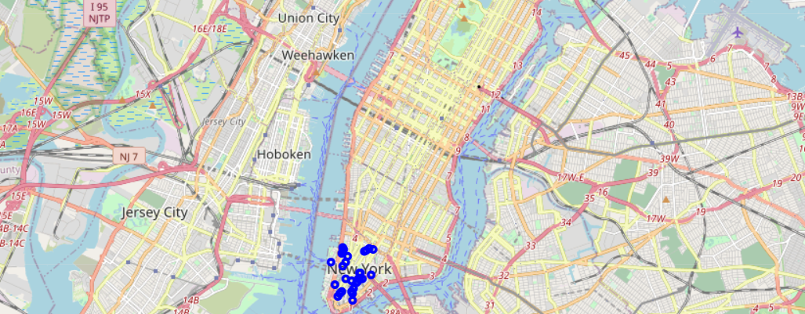
• Finally, the data be will be visually assessed using graphing from various Python libraries such as folium library.
. It's very obvious that many universities and campuses are available near these areas comparing to other academic organizations such as middle and high schools.

Slide 11
Results:
These area will be crowded with students since many universities & Colleges surrounding this area comparing to other academic organizations such as schools or community colleges. Therefore I can expect that my book store will be great to target this segments of students.

